Slide 1
Low-latitudes and equatorial zonal jets in the ocean
Claire Ménesguen
17th-21st November, 2025

Slide 2


My story with the zonal jets in the ocean
Other stuff
Other stuff
Other stuff
PhD on equatorial Jets
Audrey’s PhD on Low-latitude jets
2004
2008
2017
2020
Today
Co-supervised by Lien Hua and Richard Schopp
I co-supervised Audrey Delpech with Frédéric Marin, Sophie Cravatte and Yves Morel

Slide 3
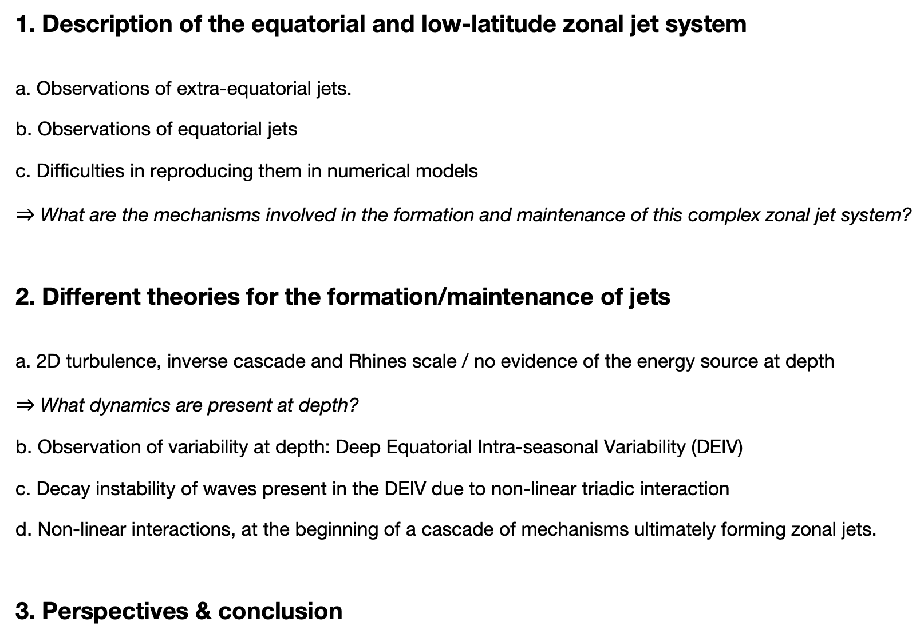
Summary
1. Description of the equatorial and low-latitude zonal jet system a. Observations of extra-equatorial jets. b. Observations of equatorial jets c. Difficulties in reproducing them in numerical models $⇒$ What are the mechanisms involved in the formation and maintenance of this complex zonal jet system?
2. Different theories for the formation/maintenance of jets a. 2D turbulence, inverse cascade and Rhines scale / no evidence of the energy source at depth $⇒$ What dynamics are present at depth? b. Observation of variability at depth: Deep Equatorial Intra-seasonal Variability (DEIV) c. Decay instability of waves present in the DEIV due to non-linear triadic interaction d. Non-linear interactions, at the beginning of a cascade of mechanisms ultimately forming zonal jets.
3. Perspectives & conclusion

Slide 4
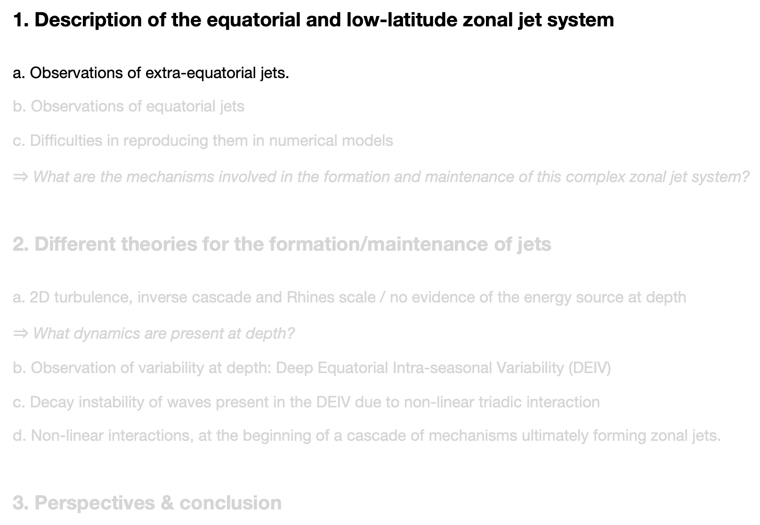
Summary
1. Description of the equatorial and low-latitude zonal jet system a. Observations of extra-equatorial jets. b. Observations of equatorial jets c. Difficulties in reproducing them in numerical models $⇒$ What are the mechanisms involved in the formation and maintenance of this complex zonal jet system?
2. Different theories for the formation/maintenance of jets a. 2D turbulence, inverse cascade and Rhines scale / no evidence of the energy source at depth $⇒$ What dynamics are present at depth? b. Observation of variability at depth: Deep Equatorial Intra-seasonal Variability (DEIV) c. Decay instability of waves present in the DEIV due to non-linear triadic interaction d. Non-linear interactions, at the beginning of a cascade of mechanisms ultimately forming zonal jets.
3. Perspectives & conclusion

Slide 5
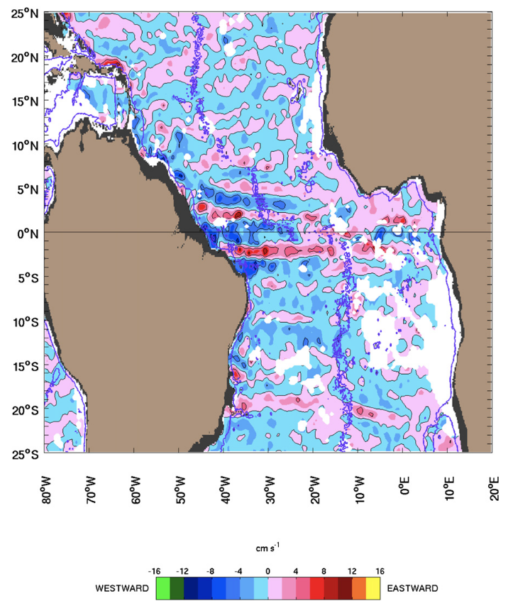
Low Latitude Deep Circulation
Global observation of the deep mean currents at 1000m, by Argo float drifts since 2000
Atlantic Ocean
2-3°
$\overline{U}$ at 1000m depth, 10yrs time average (jan 2000-dec 2009)
u, 1000m
cm/s
5 cm/s
Ollitrault et al. 2006, 2014

Slide 6
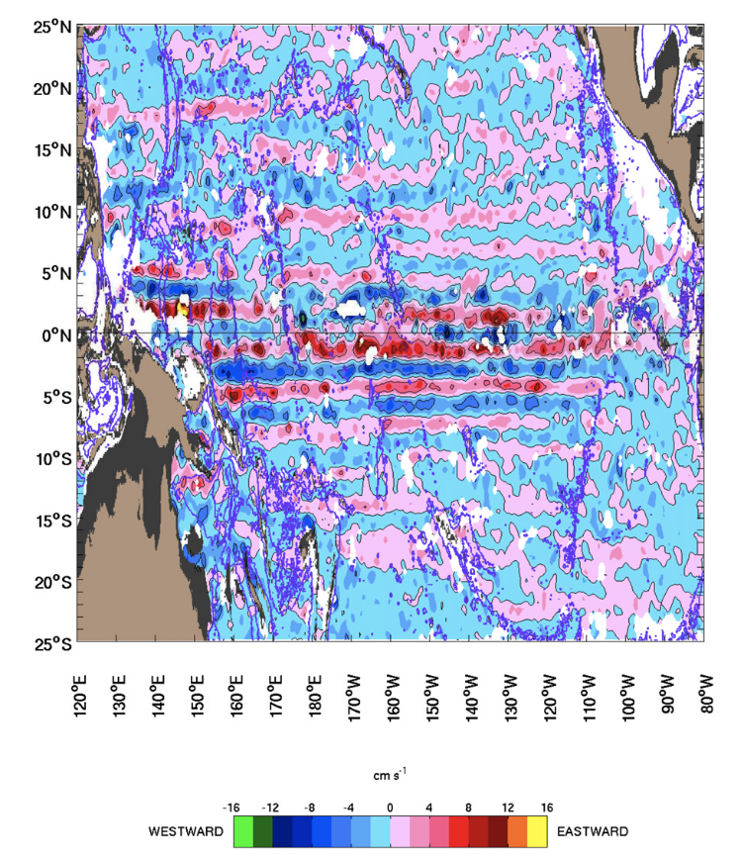
Low Latitude Deep Circulation
Global observation of the deep mean currents at 1000m, by Argo float drifts since 2000
Atlantic Ocean
u, 1000m
cm/s
Ollitrault et al. 2006, 2014
Pacific Ocean
u, 1000m
cm/s
Cravatte et al. 2012, Ollitrault et al. 2014

Slide 7
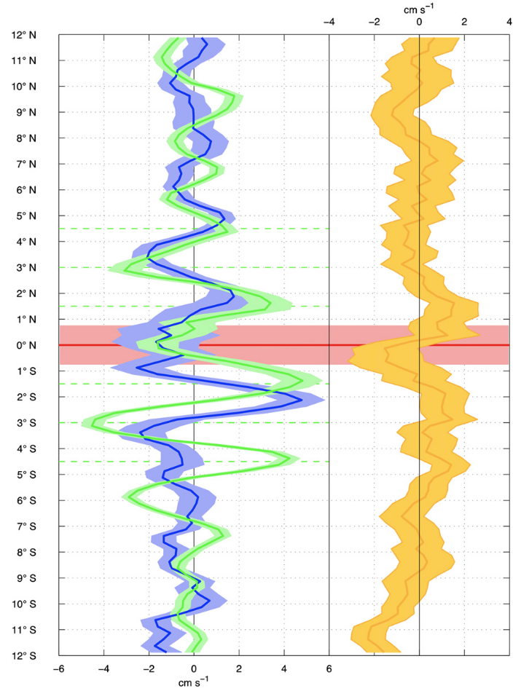
Low Latitude Deep Circulation
Global observation of the deep mean currents at 1000m, by Argo float drifts since 2000
Atlantic Ocean
Mean zonal u, averaged over the width of the Pacific, Atlantic and Indian Ocean
u, 1000m
cm/s
Ollitrault et al. 2006, 2014
Pacific Ocean
u, 1000m
cm/s
Cravatte et al. 2012, Ollitrault et al. 2014

Slide 8
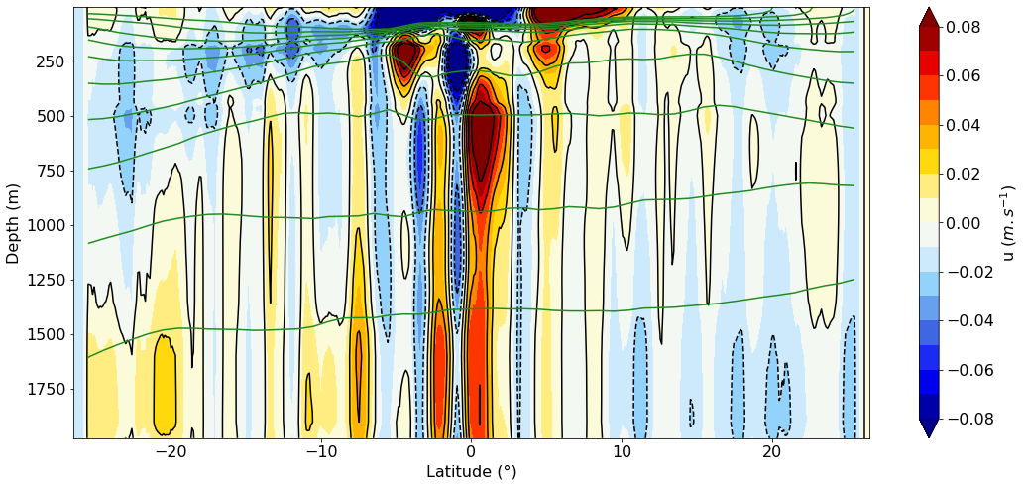
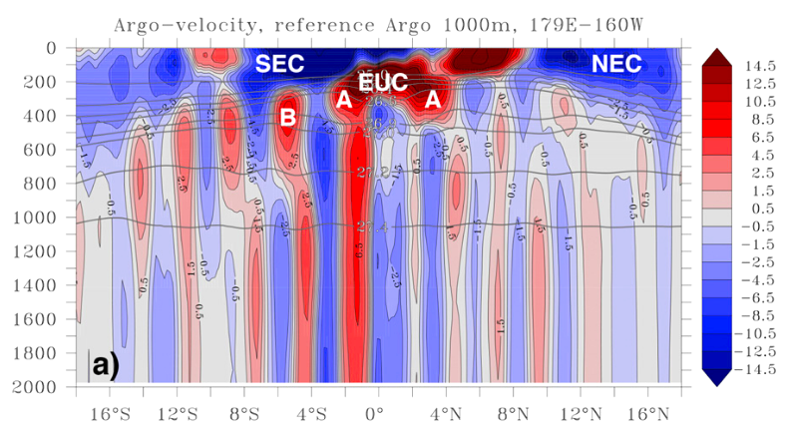
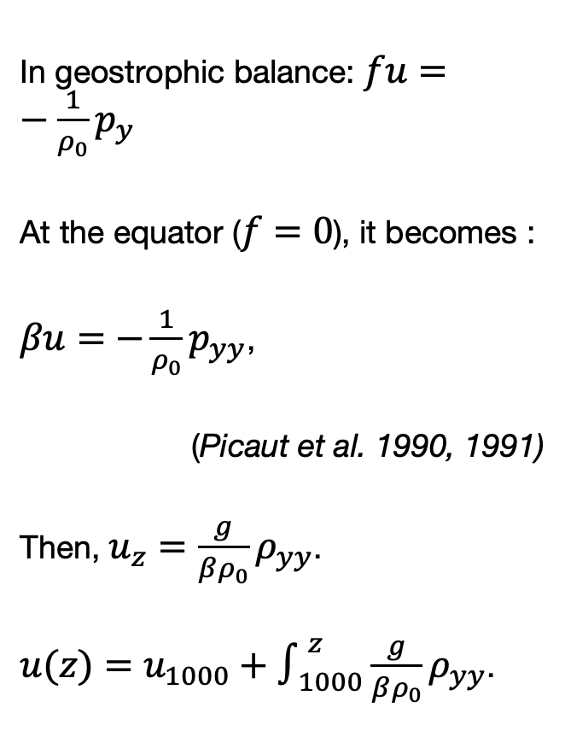
Low Latitude Deep Circulation
Atlantic Ocean
In geostrophic balance: $fu=−\frac{1}{ρ_{0}}p_{y}$
At the equator ($f=0$), it becomes :
$βu=−\frac{1}{ρ_{0}}p_{yy}$,
(Picaut et al. 1990, 1991)
Then, $u_{z}=\frac{g}{βρ_{0}}ρ_{yy}$.
$u(z)=u_{1000}+∫_{1000}^{z}\frac{g}{βρ_{0}}ρ_{yy}$.
u (m/s)
Pacific Ocean
u (cm/s)
Argo floats
Depth (m)
Roemmich & Gilson climatology
Cravatte et al. 2017

Slide 9

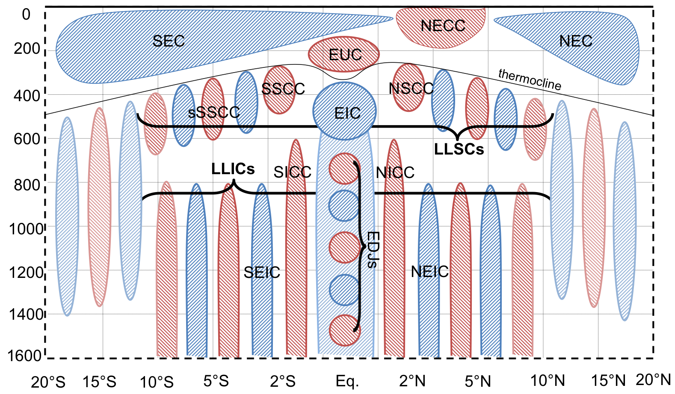
Low Latitude Deep Circulation
u (cm/s)
Depth (m)
EEJs : Extra Equatorial Jets

Slide 10
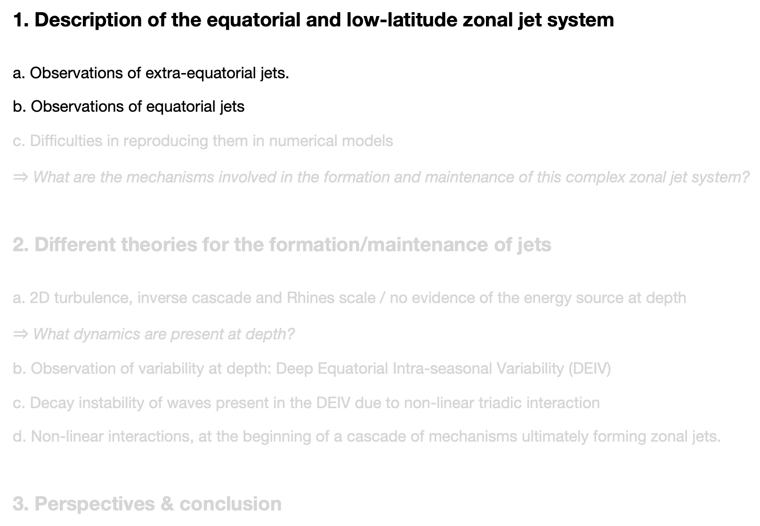
Summary
1. Description of the equatorial and low-latitude zonal jet system a. Observations of extra-equatorial jets. b. Observations of equatorial jets c. Difficulties in reproducing them in numerical models $⇒$ What are the mechanisms involved in the formation and maintenance of this complex zonal jet system?
2. Different theories for the formation/maintenance of jets a. 2D turbulence, inverse cascade and Rhines scale / no evidence of the energy source at depth $⇒$ What dynamics are present at depth? b. Observation of variability at depth: Deep Equatorial Intra-seasonal Variability (DEIV) c. Decay instability of waves present in the DEIV due to non-linear triadic interaction d. Non-linear interactions, at the beginning of a cascade of mechanisms ultimately forming zonal jets.
3. Perspectives & conclusion

Slide 11
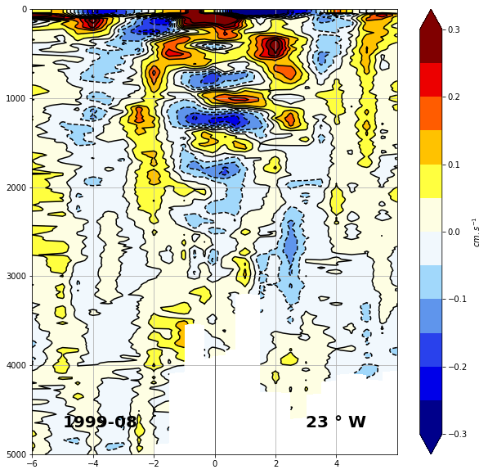
Equatorial Deep Jets
Atlantic Ocean
EQUALANT 99, 2000
20 cm/s
500 m
Gouriou et al. 1999,2001 Bourles et al. 2003

Slide 12
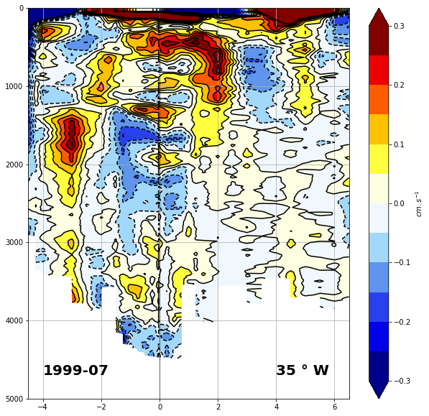
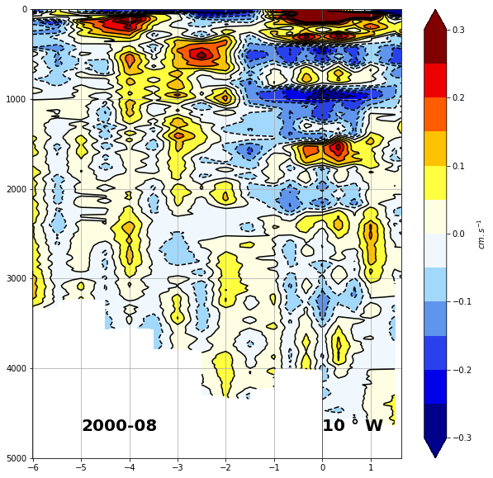
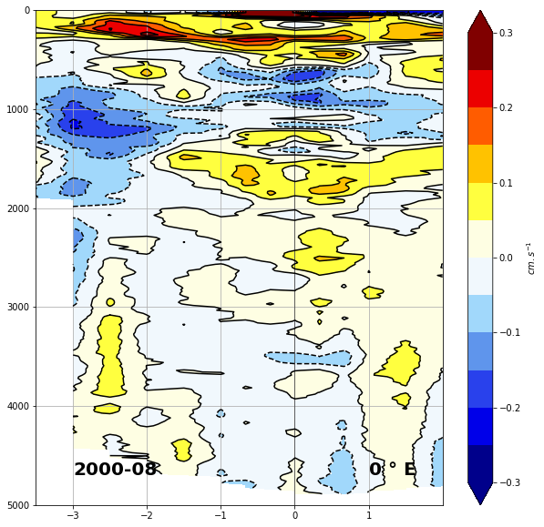
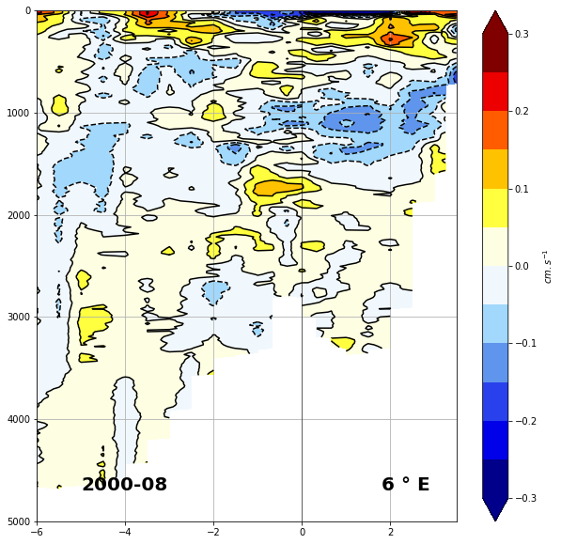
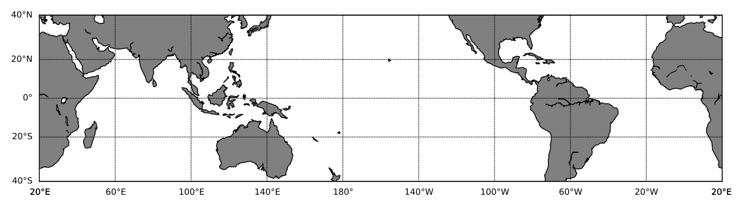
Equatorial Deep Jets
Atlantic Ocean
EQUALANT 99, 2000
Gouriou et al. 1999,2001 Bourles et al. 2003

Slide 13
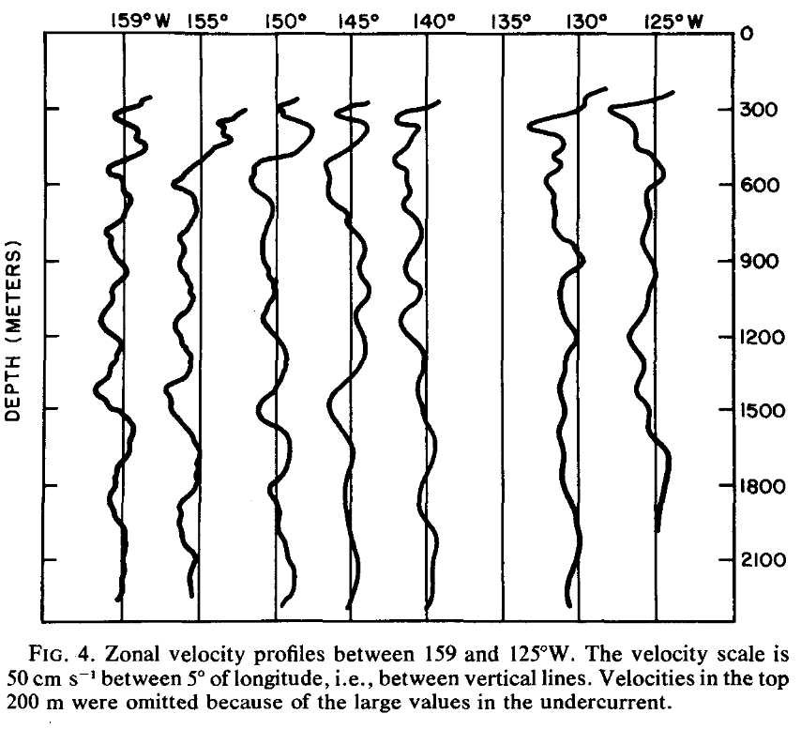
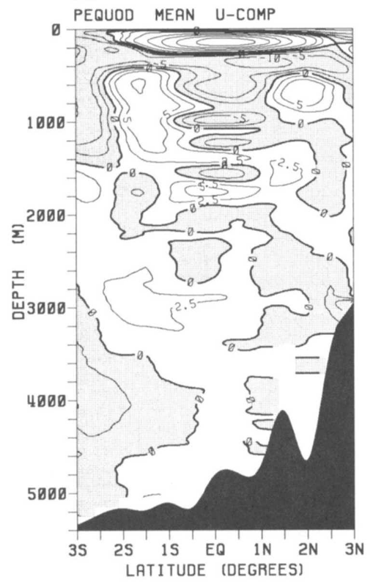
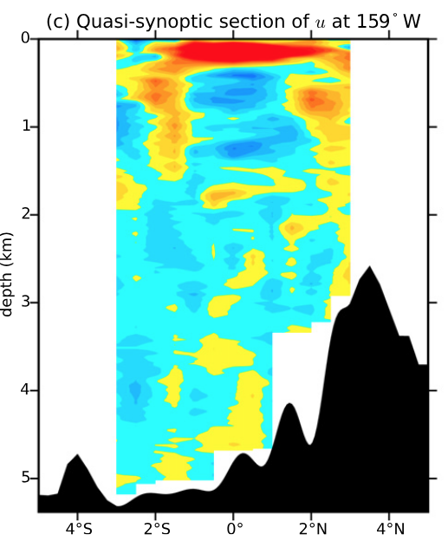
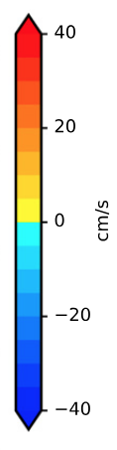
Equatorial Deep Jets
Atlantic Ocean
EQUALANT 99, 2000
Gouriou et al. 1999,2001 Bourles et al. 2003
Pacific Ocean
Leetma&Spain1981
PEQUOD, color: synoptic u, contours: mean u
Firing 1987
Ascani et al. 2015

Slide 14
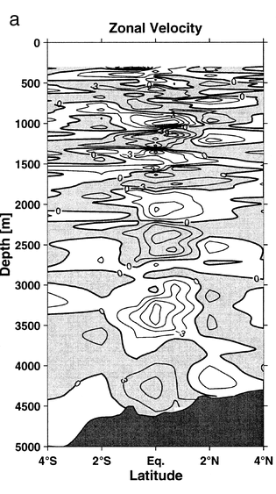
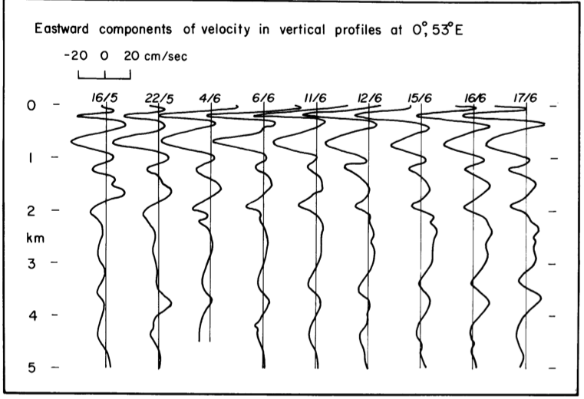
Equatorial Deep Jets
Atlantic Ocean
EQUALANT 99, 2000
Gouriou et al. 1999,2001 Bourles et al. 2003
Indian Ocean
Pacific Ocean
Luyten & Swallow, 1976
Leetma&Spain1981
PEQUOD, color: synoptic u, contours: mean u
Firing 1987
Dengler & Quadfasel, 2002
Ascani et al. 2015

Slide 15
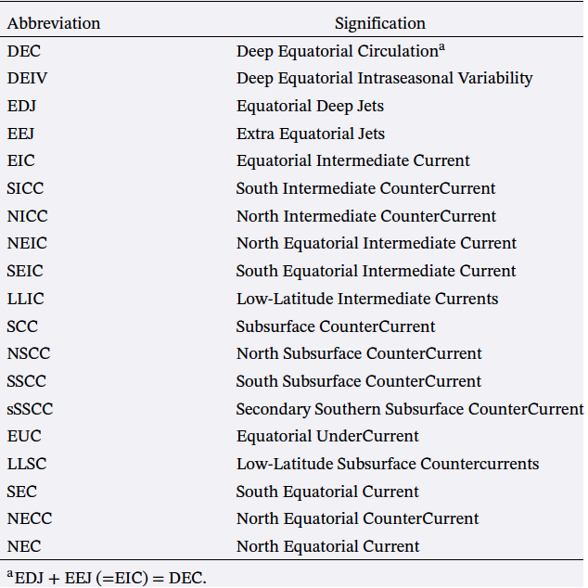
Deep Equatorial and Low-Latitude Circulation
EDJs: Equatorial Deep Jets
EEJs : Extra Equatorial Jets

Slide 16
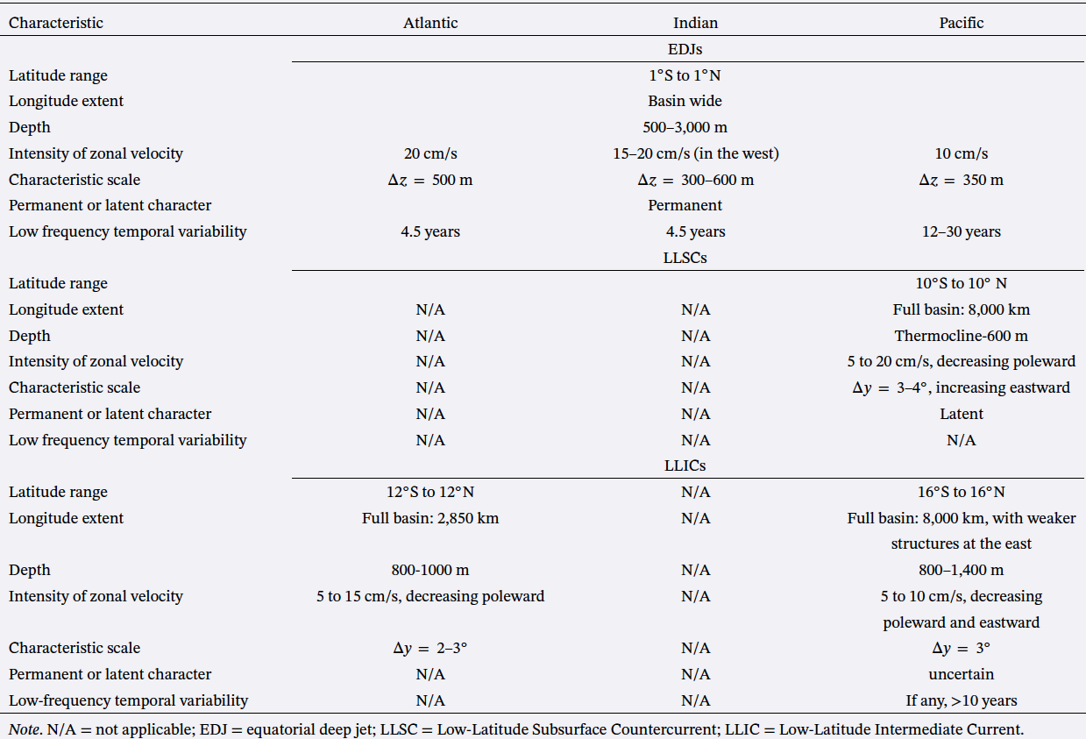
Deep Equatorial and Low-Latitude Circulation
EDJs: Equatorial Deep Jets
EEJs : Extra Equatorial Jets
Notes:
We distinguish in particular: (i) meridionally alternating off-equatorial jets with a
meridional scale of 3 within the 15 S-15 N latitude range, which have a large vertical scale
(quasi-barotropic), called Extra Equatorial Jets (EEJs); and (ii) vertically alternating equatorial jets
trapped equatorward of 2 , which have a small vertical scale of 350m, called Equatorial Deep
Jets (EDJs).

Slide 17
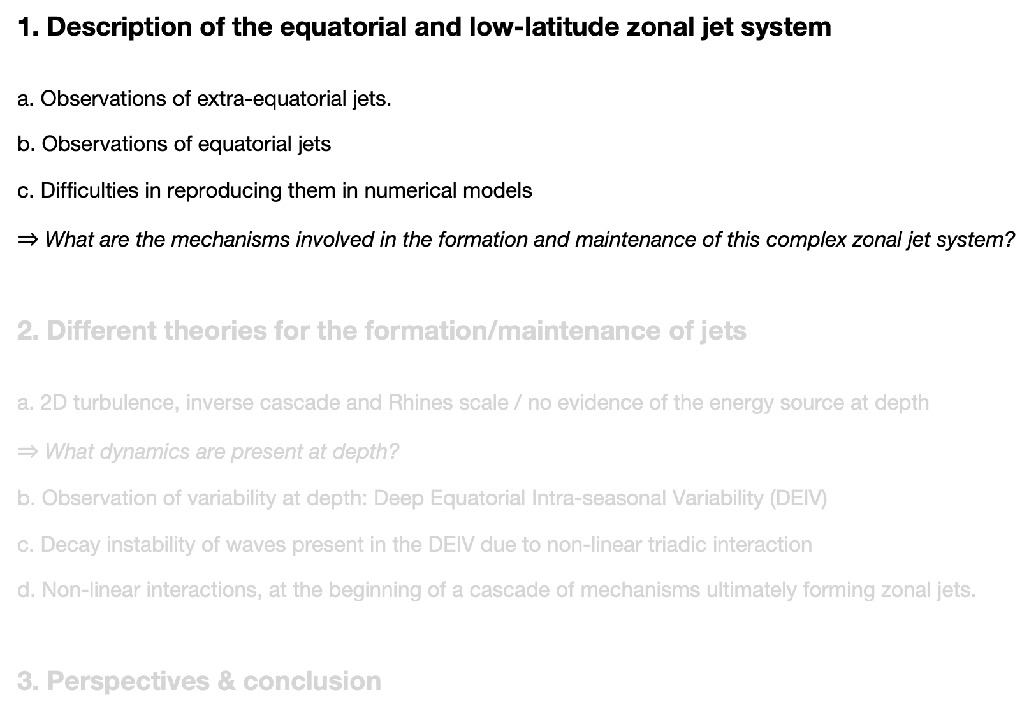
Summary
1. Description of the equatorial and low-latitude zonal jet system a. Observations of extra-equatorial jets. b. Observations of equatorial jets c. Difficulties in reproducing them in numerical models $⇒$ What are the mechanisms involved in the formation and maintenance of this complex zonal jet system?
2. Different theories for the formation/maintenance of jets a. 2D turbulence, inverse cascade and Rhines scale / no evidence of the energy source at depth $⇒$ What dynamics are present at depth? b. Observation of variability at depth: Deep Equatorial Intra-seasonal Variability (DEIV) c. Decay instability of waves present in the DEIV due to non-linear triadic interaction d. Non-linear interactions, at the beginning of a cascade of mechanisms ultimately forming zonal jets.
3. Perspectives & conclusion

Slide 18
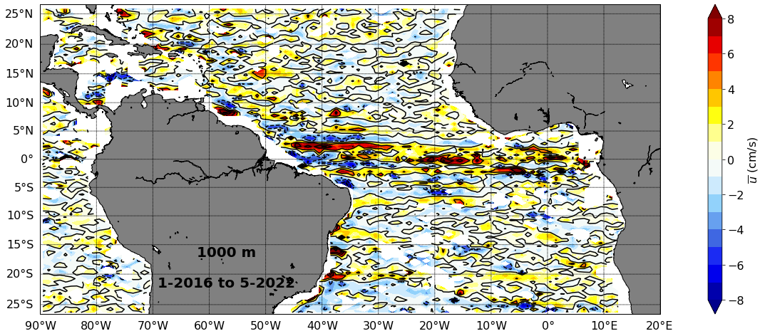
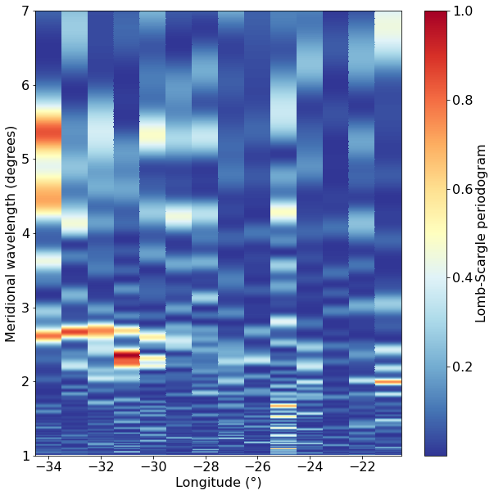

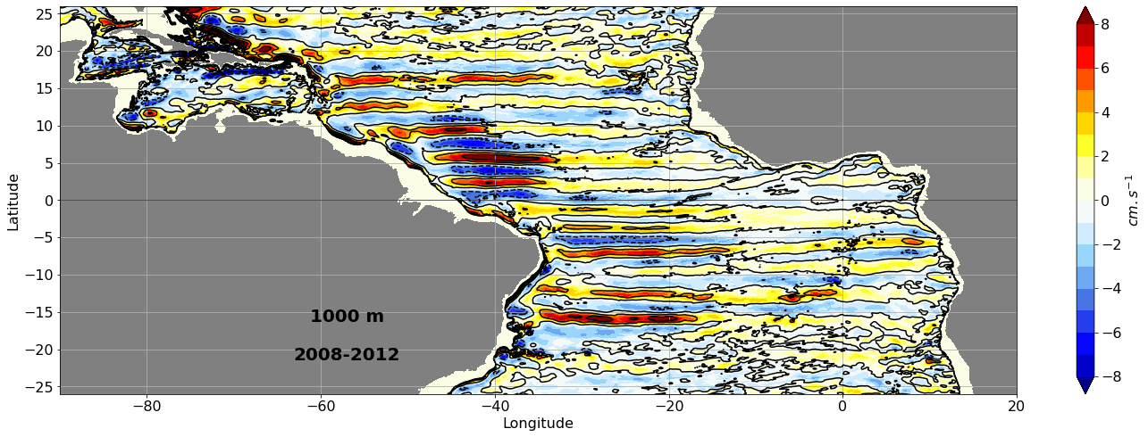
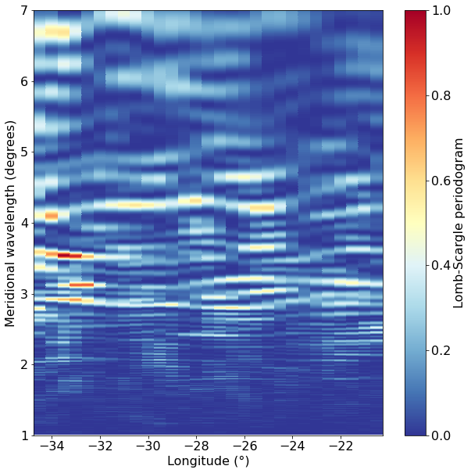
How the Deep Equatorial Circulation is represented in the numerical models?
Observations: argo
meridional wavelength (°)
3
2
GIGATL3 (without tides)
Simulation:
meridional wavelength (°)
4
3
2

Slide 19
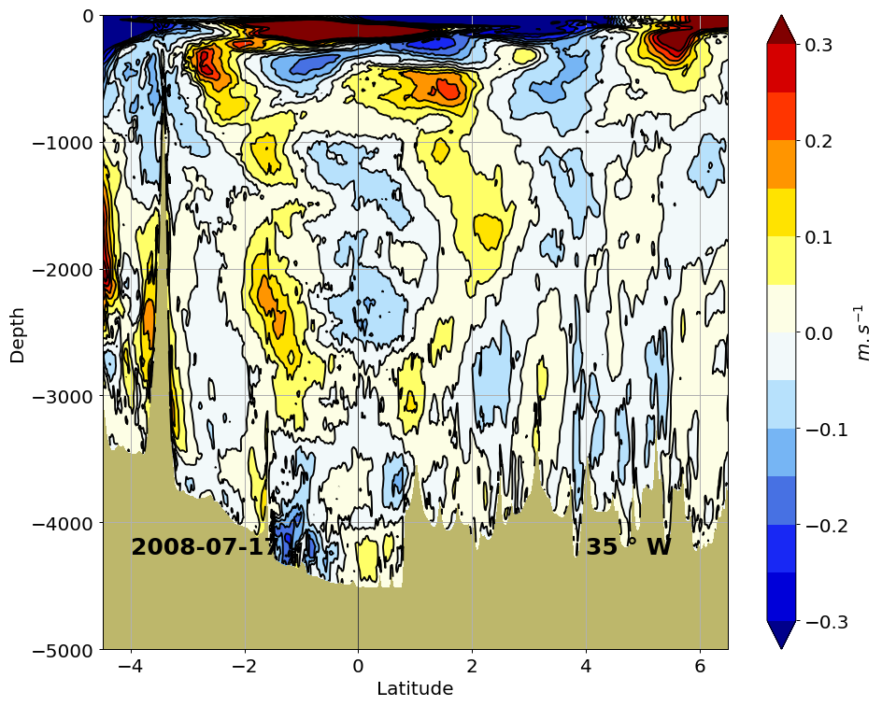
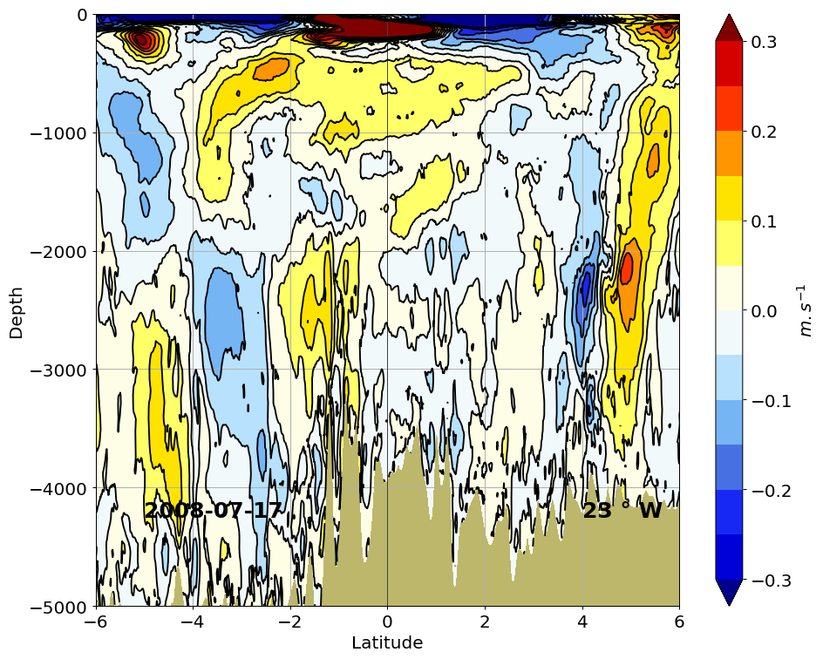
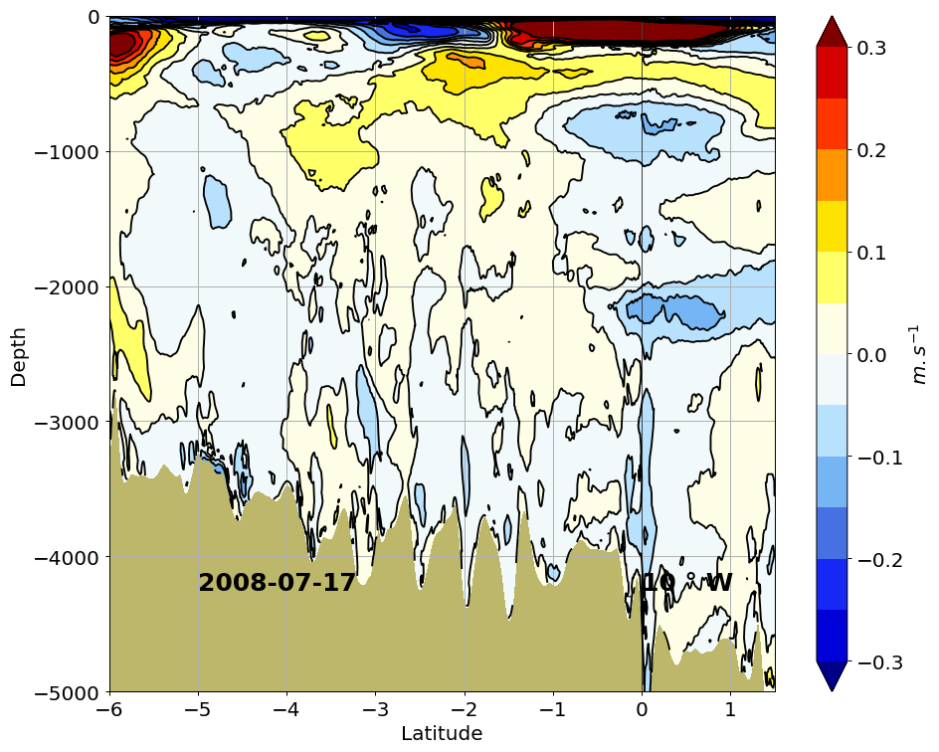
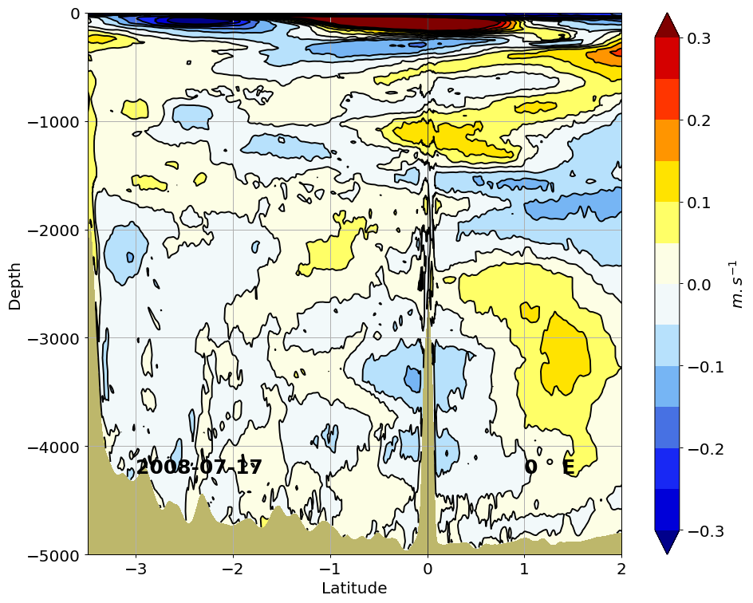
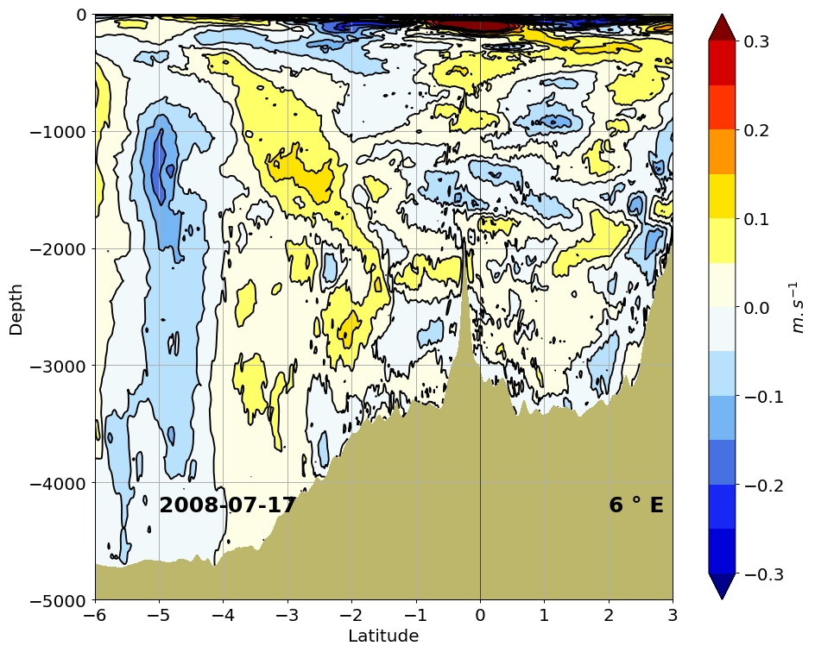
How the Deep Equatorial Circulation is represented in the numerical models?
Atlantic Ocean
EQUALANT 99, 2000
GIGATL1_tides
Simulation:
-> DEC is not well represented. It means that the reason(s) for their creation or maintenance is(are) poorly represented.
-> What are creation/maintenance mechanisms?

Slide 20
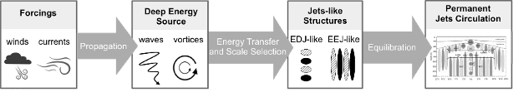
Existing theories for deep zonal jets formation
Interpretation in terms of cascade of mechanisms (Ménesguen et al. 2019)
(Audrey Delpech courtesy)
Forcings
Deep Energy Source
Jets-like Structures
Permanent Jets Circulation
winds currents
Propagation
waves vortices
Energy Transfer and Scale Selection
EDJ-like EEJ-like
Equilibration

Slide 21
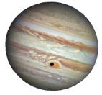

Existing theories for deep zonal jets formation
Interpretation in terms of cascade of mechanisms (Ménesguen et al. 2019)
(Audrey Delpech courtesy)
Forcings
Deep Energy Source
Jets-like Structures
Permanent Jets Circulation
winds currents
Propagation
waves vortices
Energy Transfer and Scale Selection
EDJ-like EEJ-like
Equilibration
geostrophic turbulence
inverse cascade
anisotropic vortices (ZJ-like)
Rhines (1975)
(turbulence cascade)

Slide 22
Existing theories for deep zonal jets formation
Interpretation in terms of cascade of mechanisms (Ménesguen et al. 2019)
(Audrey Delpech courtesy)
Forcings
Deep Energy Source
Jets-like Structures
Permanent Jets Circulation
winds currents
Propagation
waves vortices
Energy Transfer and Scale Selection
EDJ-like EEJ-like
Equilibration
geostrophic turbulence
inverse cascade
anisotropic vortices (ZJ-like)
Rhines (1975)
(turbulence cascade)
short barotropic Rossby waves
instability
long barotropic Rossby waves (ZJ-like)
Gill (1974)
(wave instability)

Slide 23
Existing theories for deep zonal jets formation
Interpretation in terms of cascade of mechanisms (Ménesguen et al. 2019)
(Audrey Delpech courtesy)
Forcings
Deep Energy Source
Jets-like Structures
Permanent Jets Circulation
winds currents
Propagation
waves vortices
Energy Transfer and Scale Selection
EDJ-like EEJ-like
Equilibration
geostrophic turbulence
inverse cascade
anisotropic vortices (ZJ-like)
Rhines (1975)
(turbulence cascade)
short barotropic Rossby waves
instability
long barotropic Rossby waves (ZJ-like)
Gill (1974)
2 theories developed for homogeneous fluids and at mid-latitudes.
(wave instability)

Slide 24
Existing theories for deep zonal jets formation
Interpretation in terms of cascade of mechanisms (Ménesguen et al. 2019)
(Audrey Delpech courtesy)
Forcings
Deep Energy Source
Jets-like Structures
Permanent Jets Circulation
winds currents
Propagation
waves vortices
Energy Transfer and Scale Selection
EDJ-like EEJ-like
Equilibration
geostrophic turbulence
inverse cascade
anisotropic vortices (ZJ-like)
Rhines (1975)
(turbulence cascade)
short barotropic Rossby waves
instability
long barotropic Rossby waves (ZJ-like)
Gill (1974)
2 theories developed for homogeneous fluids and at mid-latitudes.
(wave instability)
Need of assessing realistically the deep energy sources in the ocean to discriminate the process at play.

Slide 25
Existing theories for deep zonal jets formation
Interpretation in terms of cascade of mechanisms (Ménesguen et al. 2019)
(Audrey Delpech courtesy)
Forcings
Deep Energy Source
Jets-like Structures
Permanent Jets Circulation
winds currents
Propagation
waves vortices
Energy Transfer and Scale Selection
EDJ-like EEJ-like
Equilibration
geostrophic turbulence
inverse cascade
anisotropic vortices (ZJ-like)
Rhines (1975)
(turbulence cascade)
short barotropic Rossby waves
instability
long barotropic Rossby waves (ZJ-like)
Gill (1974)
2 theories developed for homogeneous fluids and at mid-latitudes.
(wave instability)
Need of assessing realistically the deep energy sources in the ocean to discriminate the process at play.
Need to validate the relevance of these processes at the equator and low latitudes

Slide 26
Existing theories for deep zonal jets formation
Interpretation in terms of cascade of mechanisms (Ménesguen et al. 2019)
(Audrey Delpech courtesy)
Forcings
Deep Energy Source
Jets-like Structures
Permanent Jets Circulation
winds currents
Propagation
waves vortices
Energy Transfer and Scale Selection
EDJ-like EEJ-like
Equilibration
geostrophic turbulence
inverse cascade
anisotropic vortices (ZJ-like)
Rhines (1975)
(turbulence cascade)
short barotropic Rossby waves
instability
long barotropic Rossby waves (ZJ-like)
Gill (1974)
2 theories developed for homogeneous fluids and at mid-latitudes.
(wave instability)
Need of assessing realistically the deep energy sources in the ocean to discriminate the process at play.
Need to validate the relevance of these processes at the equator and low latitudes

Slide 27
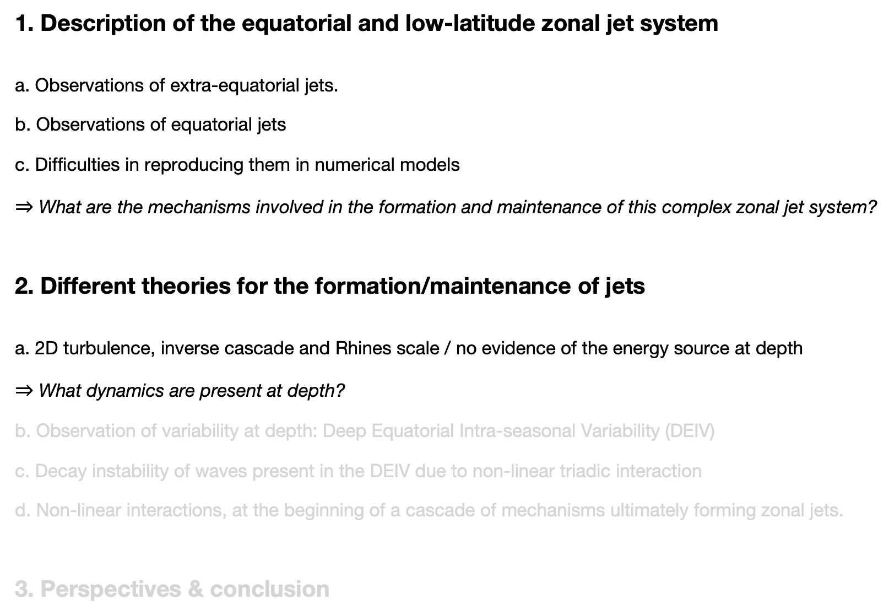
Summary
1. Description of the equatorial and low-latitude zonal jet system a. Observations of extra-equatorial jets. b. Observations of equatorial jets c. Difficulties in reproducing them in numerical models $⇒$ What are the mechanisms involved in the formation and maintenance of this complex zonal jet system?
2. Different theories for the formation/maintenance of jets a. 2D turbulence, inverse cascade and Rhines scale / no evidence of the energy source at depth $⇒$ What dynamics are present at depth? b. Observation of variability at depth: Deep Equatorial Intra-seasonal Variability (DEIV) c. Decay instability of waves present in the DEIV due to non-linear triadic interaction d. Non-linear interactions, at the beginning of a cascade of mechanisms ultimately forming zonal jets.
3. Perspectives & conclusion

Slide 28
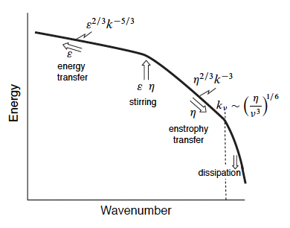
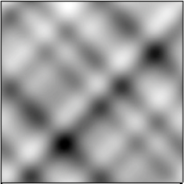
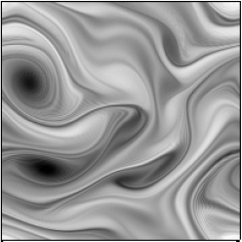
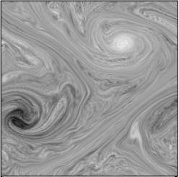
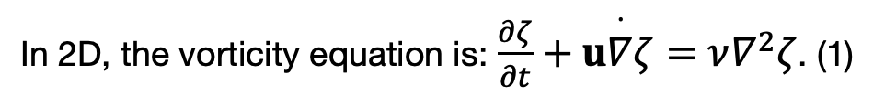
Inverse cascade in 2D geostrophic turbulence
In 2D, the vorticity equation is: $\frac{∂ζ}{∂t}+u\overset{·}{∇}ζ=ν∇^{2}ζ$. (1)
Time: inverse cascade of energy
Free evolution of vorticity in a doubly periodic square domain, obeying (1) with a weak viscous term on the righthandside.
Vallis, Book 2017

Slide 29
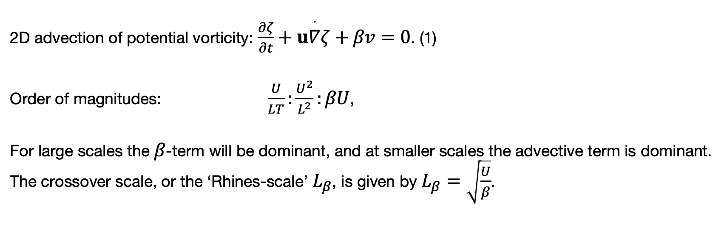
Inverse cascade in 2D geostrophic turbulence on a $β$-plane. Rhines-scale
2D advection of potential vorticity: $\frac{∂ζ}{∂t}+u\overset{·}{∇}ζ+βv=0$. (1)
Order of magnitudes: $\frac{U}{LT}:\frac{U^{2}}{L^{2}}:βU$,
For large scales the $β$-term will be dominant, and at smaller scales the advective term is dominant. The crossover scale, or the ‘Rhines-scale’ $L_{β}$, is given by $L_{β}=\sqrt{\frac{U}{β}}$.
Notes:
https://www.youtube.com/watch?v=ZtzW25NooDk

Slide 30
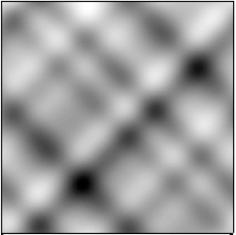
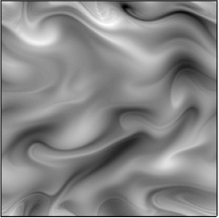
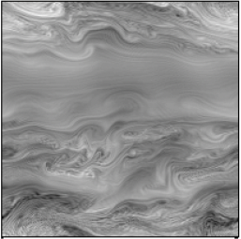

Inverse cascade in 2D geostrophic turbulence on a $β$-plane. Rhines-scale
2D advection of potential vorticity: $\frac{∂ζ}{∂t}+u\overset{·}{∇}ζ+βv=0$. (1)
Order of magnitudes: $\frac{U}{LT}:\frac{U^{2}}{L^{2}}:βU$,
For large scales the $β$-term will be dominant, and at smaller scales the advective term is dominant. The crossover scale, or the ‘Rhines-scale’ $L_{β}$, is given by $L_{β}=\sqrt{\frac{U}{β}}$.
Time: anisotropic inverse cascade
$L_{β}$ ?
t=0
t=50
t=260
Free evolution of vorticity in a doubly periodic square domain, obeying (1) with the addition of a weak viscous term on the rhs.
Vallis, Book 2017
Notes:
https://www.youtube.com/watch?v=ZtzW25NooDk

Slide 31
Inverse cascade in 2D geostrophic turbulence on a $β$-plane. Rhines-scale
2D advection of potential vorticity: $\frac{∂ζ}{∂t}+u\overset{·}{∇}ζ+βv=0$. (1)
Order of magnitudes: $\frac{U}{LT}:\frac{U^{2}}{L^{2}}:βU$,
For large scales the $β$-term will be dominant, and at smaller scales the advective term is dominant. The crossover scale, or the ‘Rhines-scale’ $L_{β}$, is given by $L_{β}=\sqrt{\frac{U}{β}}$.
Time: anisotropic inverse cascade
$L_{β}$ ?
t=0
t=50
t=260
Free evolution of vorticity in a doubly periodic square domain, obeying (1) with the addition of a weak viscous term on the rhs.
None of the order of magnitudes discussed so far take into account the anisotropy inherent in Rossby waves, nor do they suggest how the flow might organize itself into zonal structures.
Vallis, Book 2017
Notes:
https://www.youtube.com/watch?v=ZtzW25NooDk

Slide 32
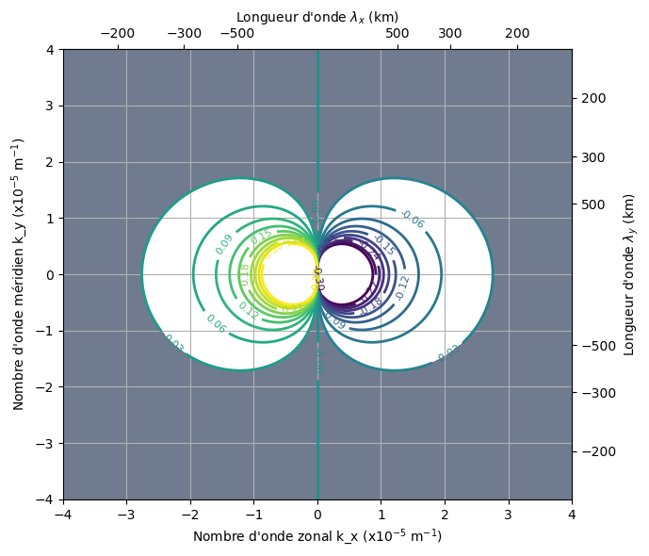
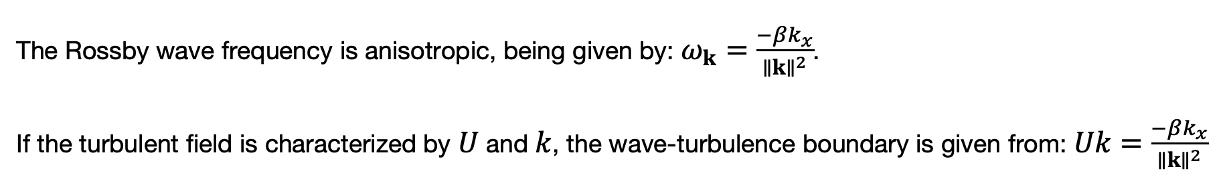
Inverse cascade in 2D geostrophic turbulence - zonal jets
The Rossby wave frequency is anisotropic, being given by: $ω_{k}=\frac{−βk_{x}}{∥k∥^{2}}$.
If the turbulent field is characterized by $U$ and $k$, the wave-turbulence boundary is given from: $Uk=\frac{−βk_{x}}{∥k∥^{2}}$
U = 0.03 m/s
Rossby waves
Turbulence
Vallis & Maltrud 1992
Notes:
Pour un U donné, ex: 3cm/s: la courbe délimite turb/onde
Grandes échelles spatiales: on tombe facilement dans le dumbell = ondes
Petites ech= turbulence
Pour U= 6cm/s:
Il faut des plus grandes échelles spatiales (petits k) pour tomber dans les ondes.

Slide 33
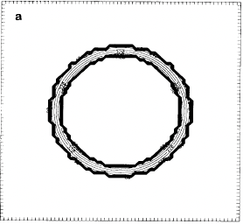
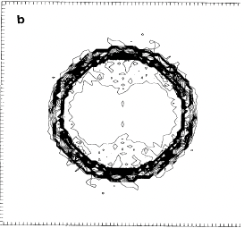










Inverse cascade in 2D geostrophic turbulence - zonal jets
$L_{β}$ ?
t=0
t=50
t=260
Free evolution of vorticity in a doubly periodic square domain, obeying (1) with the addition of a weak viscous term on the rhs.
Time
$k_{x}=0⇔$zonal jet
anisotropic inverse cascade
$∼k_{β}$
$$k_{y}$$
$$k_{y}$$
$$k_{y}$$
$$k_{x}$$
$$k_{x}$$
$$k_{x}$$
Energy spectrum time evolution in the (kx,ky) space
Vallis, Book 2017

Slide 34

Inverse cascade in the deep ocean?
Atlantic Ocean
U = 0.03 m/s
$λ_{y}$ = 2-3${}^{∘}$.
Rossby waves
u, 1000m
Turbulence
cm/s
Ollitrault et al. 2006, 2014
To maintain realistic EEJ, we should have a soup of turbulence, at depth, maintained with u_rms~0.03m/s. realistic?
Pacific Ocean
u, 1000m
cm/s
Cravatte et al. 2012, Ollitrault et al. 2014
Notes:
Dans la théorie ‘turbulence’, si on veut avoir une turbulence qui finit en jets avec 2-3 degrés de latitudes comme échelle, on doit avoir un U turbulent de 6 cm/s

Slide 35

Summary
1. Description of the equatorial and low-latitude zonal jet system a. Observations of extra-equatorial jets. b. Observations of equatorial jets c. Difficulties in reproducing them in numerical models $⇒$ What are the mechanisms involved in the formation and maintenance of this complex zonal jet system?
2. Different theories for the formation/maintenance of jets a. 2D turbulence, inverse cascade and Rhines scale / no evidence of the energy source at depth $⇒$ What dynamics are present at depth? b. Observation of variability at depth: Deep Equatorial Intra-seasonal Variability (DEIV) c. Decay instability of waves present in the DEIV due to non-linear triadic interaction d. Non-linear interactions, at the beginning of a cascade of mechanisms ultimately forming zonal jets.
3. Perspectives & conclusion

Slide 36



Deep Equatorial Intraseasonal Variability
Atlantic Ocean
$eke_{|v}$, 1000m
$eke_{|v}=(v−\overline{v})^{2}$, with $\overline{v}$ the time average 2000-2016
No noticeable $eke_{|u}$

Slide 37






Deep Equatorial Intraseasonal Variability
Atlantic Ocean
$eke_{|v}=(v−\overline{v})^{2}$, with $\overline{v}$ the time average 2000-2016
No noticeable $eke_{|u}$
$eke_{|v}$, 1000m
Pacific Ocean
$eke_{|v}$, 1000m
Indian Ocean
$eke_{|v}$, 1000m
Ménesguen et al. 2019

Slide 38
Deep Equatorial Intraseasonal Variability
Pacific Ocean
(149 °E - 88°W & 7°S and 7°N)
Zonal wavenumber - frequency power spectrum of SSH (averaged 1993-2006)
At the surface: presence of linear waves, with a wide range of periods and wavenumbers
Farrar 2008

Slide 39


Deep Equatorial Intraseasonal Variability
Pacific Ocean
(149 °E - 88°W & 7°S and 7°N)
Zonal wavenumber - frequency power spectrum of SSH (averaged 1993-2006)
At the surface: presence of linear waves, with a wide range of periods and wavenumbers
Farrar 2008
At depth: penetration of energy from the surface at annual and intra-seasonal periods
Atlantic Ocean
Observations: mooring at 23°W, 0°N, dt=1h
period (days)
365
180
50
40
30
20
15
12
0
20
0
1000
1000
Depth (m)
v (cm/s)
Depth (m)
3000
3000
-20
annual
intra-seasonal
Lombscargle periodogram between ‘2004-02-01' and '2020-01-01'
Tuchen et al. 2018

Slide 40

Deep Equatorial Intraseasonal Variability
Surface obs.
Inertia-gravity waves
Deep obs.
6 vertical modes
2nd meridional mode
Yanai waves
Farrar & Durland (2012)
Tropical Instability Waves (e.g. Lyman et al. 2007)
Kelvin waves
Farrar (2011)
Rossby waves
Farrar (208)
Delpech et al. (2020)
Farrar & Weller (2006)
e.g. Kessler & McCreary (1993)
Notes:
It has been shown that in the Atlantic and Pacific ocean, a large source of energy in the
deep is associated with annual and semi-annual Rossby waves, as well as intra-annual waves:
30-day, 1000-km mixed Rossby-gravity waves, associated with surface Tropical InstabilityWaves;
and short-scale variability, with periods around 70 days and wavelengths around 500 km
Equatorial waves, when generated at the surface,
propagate to depth. In the intra-annual range in particular, waves have steep propagation ray paths
(Cox 1980) and are thus very efficient at transferring energy to the deep ocean.

Slide 41

Summary
1. Description of the equatorial and low-latitude zonal jet system a. Observations of extra-equatorial jets. b. Observations of equatorial jets c. Difficulties in reproducing them in numerical models $⇒$ What are the mechanisms involved in the formation and maintenance of this complex zonal jet system?
2. Different theories for the formation/maintenance of jets a. 2D turbulence, inverse cascade and Rhines scale / no evidence of the energy source at depth $⇒$ What dynamics are present at depth? b. Observation of variability at depth: Deep Equatorial Intra-seasonal Variability (DEIV) c. Decay instability of waves present in the DEIV due to non-linear triadic interaction d. Non-linear interactions, at the beginning of a cascade of mechanisms ultimately forming zonal jets.
3. Perspectives & conclusion

Slide 42
Existing theories for deep zonal jets formation
Interpretation in terms of cascade of mechanisms (Ménesguen et al. 2019)
(Audrey Delpech courtesy)
Forcings
Deep Energy Source
Jets-like Structures
Permanent Jets Circulation
winds currents
Propagation
waves vortices
Energy Transfer and Scale Selection
EDJ-like EEJ-like
Equilibration
geostrophic turbulence
inverse cascade
anisotropic vortices (ZJ-like)
Rhines (1975)
(turbulence cascade)
short barotropic Rossby waves
instability
long barotropic Rossby waves (ZJ-like)
Gill (1974)
2 theories developed for homogeneous fluids and at mid-latitudes.
(wave instability)
Need of assessing realistically the deep energy sources in the ocean to discriminate the process at play.
Need to validate the relevance of these processes at the equator and low latitudes

Slide 43

Nonlinearity parameter M
The two dimensional quasi-geostrophic equation for the streamfunction $ψ$ is:
$\frac{∂}{∂t}\left(∇^{2}ψ−\frac{1}{L_{R}^{2}}ψ\right)+β\frac{∂ψ}{∂x}+J(ψ,∇^{2}ψ)=0$,
with $L_{R}=\frac{\sqrt{gH}}{f_{0}}$.
$$M=\frac{J(ψ,∇^{2}ψ)}{β\frac{∂ψ}{∂x}}=\frac{non−linear}{β}∼\frac{Up^{2}}{β}$$
(Gill 74, Connaughton et al. 2010)

Slide 44


Nonlinearity parameter M
The two dimensional quasi-geostrophic equation for the streamfunction $ψ$ is:
$\frac{∂}{∂t}\left(∇^{2}ψ−\frac{1}{L_{R}^{2}}ψ\right)+β\frac{∂ψ}{∂x}+J(ψ,∇^{2}ψ)=0$,
with $L_{R}=\frac{\sqrt{gH}}{f_{0}}$.
$$M=\frac{J(ψ,∇^{2}ψ)}{β\frac{∂ψ}{∂x}}=\frac{non−linear}{β}∼\frac{Up^{2}}{β}$$
(Gill 74, Connaughton et al. 2010)
$M>>1$: $β$-effect is small. Nonlinearities are strong, and can result in a turbulent regime.
$M<<1$: non-linearities are weak. Waves weakly interact and perturbation can grow in resonant triad.
$M∼1$: Rhines scale: crossover from the turbulence regime to the wave behavior.
Turbulence, $$M>>1$$

Slide 45

Nonlinearity parameter M
The two dimensional quasi-geostrophic equation for the streamfunction $ψ$ is:
$\frac{∂}{∂t}\left(∇^{2}ψ−\frac{1}{L_{R}^{2}}ψ\right)+β\frac{∂ψ}{∂x}+J(ψ,∇^{2}ψ)=0$,
with $L_{R}=\frac{\sqrt{gH}}{f_{0}}$.
$$M=\frac{J(ψ,∇^{2}ψ)}{β\frac{∂ψ}{∂x}}=\frac{non−linear}{β}∼\frac{Up^{2}}{β}$$
(Gill 74, Connaughton et al. 2010)
$M>>1$: $β$-effect is small. Nonlinearities are strong, and can result in a turbulent regime.
$M<<1$: non-linearities are weak. Waves weakly interact and perturbation can grow in resonant triad.
$M∼1$: Rhines scale: crossover from the turbulence regime to the wave behavior.
Rossby, $M<<1$ waves
Turbulence, $$M>>1$$

Slide 46

Nonlinearity parameter M
The two dimensional quasi-geostrophic equation for the streamfunction $ψ$ is:
$\frac{∂}{∂t}\left(∇^{2}ψ−\frac{1}{L_{R}^{2}}ψ\right)+β\frac{∂ψ}{∂x}+J(ψ,∇^{2}ψ)=0$,
with $L_{R}=\frac{\sqrt{gH}}{f_{0}}$.
$$M=\frac{J(ψ,∇^{2}ψ)}{β\frac{∂ψ}{∂x}}=\frac{non−linear}{β}∼\frac{Up^{2}}{β}$$
(Gill 74, Connaughton et al. 2010)
$M>>1$: $β$-effect is small. Nonlinearities are strong, and can result in a turbulent regime.
$M<<1$: non-linearities are weak. Waves weakly interact and perturbation can grow in resonant triad.
$M∼1$: Rhines scale: crossover from the turbulence regime to the wave behavior.
Rhines scale, $$M∼1$$
Rossby, $M<<1$ waves
Turbulence, $$M>>1$$

Slide 47
Nonlinearity parameter M
The two dimensional quasi-geostrophic equation for the streamfunction $ψ$ is:
$\frac{∂}{∂t}\left(∇^{2}ψ−\frac{1}{L_{R}^{2}}ψ\right)+β\frac{∂ψ}{∂x}+J(ψ,∇^{2}ψ)=0$,
with $L_{R}=\frac{\sqrt{gH}}{f_{0}}$.
$$M=\frac{J(ψ,∇^{2}ψ)}{β\frac{∂ψ}{∂x}}=\frac{non−linear}{β}∼\frac{Up^{2}}{β}$$
(Gill 74, Connaughton et al. 2010)
$M>>1$: $β$-effect is small. Nonlinearities are strong, and can result in a turbulent regime.
$M<<1$: non-linearities are weak. Waves weakly interact and perturbation can grow in resonant triad.
$M∼1$: Rhines scale: crossover from the turbulence regime to the wave behavior.
Rhines scale, $$M∼1$$
Rossby, $M<<1$ waves
Turbulence, $$M>>1$$
Gill (1974)

Slide 48

Stability of waves on a $β$-plane, for $M>>1$ and $M<<1$
The two dimensional quasi-geostrophic equation for the streamfunction $ψ$ is:
$\frac{∂}{∂t}\left(∇^{2}ψ−\frac{1}{L_{R}^{2}}ψ\right)+β\frac{∂ψ}{∂x}+J(ψ,∇^{2}ψ)=0$, with $L_{R}=\frac{\sqrt{gH}}{f_{0}}$.
A primary wave is given by: $Ψ=\frac{U}{κ}sinθ$, with $θ=kx+ly+ωt$.
step 1: equation for a perturbation $ψ$ linearized around the primary wave
step 2: Fourier transform of the perturbation and truncation to 3 waves for the perturbation.
step 3: looking for solutions in the 2 limits: $M>>1$ and $M<<1$
Gill (1974)

Slide 49
Stability of waves on a $β$-plane, for $M>>1$ and $M<<1$
The two dimensional quasi-geostrophic equation for the streamfunction $ψ$ is:
$\frac{∂}{∂t}\left(∇^{2}ψ−\frac{1}{L_{R}^{2}}ψ\right)+β\frac{∂ψ}{∂x}+J(ψ,∇^{2}ψ)=0$, with $L_{R}=\frac{\sqrt{gH}}{f_{0}}$.
A primary wave is given by: $Ψ=\frac{U}{κ}sinθ$, with $θ=kx+ly+ωt$.
step 1: equation for a perturbation $ψ$ linearized around the primary wave
step 2: Fourier transform of the perturbation and truncation to 3 waves for the perturbation.
step 3: looking for solutions in the 2 limits: $M>>1$ and $M<<1$
Gill (1974)

Slide 50
Stability of waves on a $β$-plane, for $M>>1$ and $M<<1$
The two dimensional quasi-geostrophic equation for the streamfunction $ψ$ is:
$\frac{∂}{∂t}\left(∇^{2}ψ−\frac{1}{L_{R}^{2}}ψ\right)+β\frac{∂ψ}{∂x}+J(ψ,∇^{2}ψ)=0$, with $L_{R}=\frac{\sqrt{gH}}{f_{0}}$.
A primary wave is given by: $Ψ=\frac{U}{κ}sinθ$, with $θ=kx+ly+ωt$.
step 1: equation for a perturbation $ψ$ linearized around the primary wave
step 2: Fourier transform of the perturbation and truncation to 3 waves for the perturbation.
step 3: looking for solutions in the 2 limits: $M>>1$ and $M<<1$
Gill (1974)

Slide 51







Stability of waves on a $β$-plane, for $M>>1$ and $M<<1$
The two dimensional quasi-geostrophic equation for the streamfunction $ψ$ is:
$\frac{∂}{∂t}\left(∇^{2}ψ−\frac{1}{L_{R}^{2}}ψ\right)+β\frac{∂ψ}{∂x}+J(ψ,∇^{2}ψ)=0$, with $L_{R}=\frac{\sqrt{gH}}{f_{0}}$.
A primary wave is given by: $Ψ=\frac{U}{κ}sinθ$, with $θ=kx+ly+ωt$.
step 1: equation for a perturbation $ψ$ linearized around the primary wave
step 2: Fourier transform of the perturbation and truncation to 3 waves for the perturbation.
step 3: looking for solutions in the 2 limits: $M>>1$ and $M<<1$
Gill (1974)
unstable wavenumbers
$⇒$ for $M>>1$, no $β$-effect. Similar to the destabilization of a parallel flow with a sinusoidal velocity distribution
$$p$$
$$k_{−1}$$
$$q$$
$$k_{1}$$
$$k_{2}$$

Slide 52




Stability of waves on a $β$-plane, for $M>>1$ and $M<<1$
The two dimensional quasi-geostrophic equation for the streamfunction $ψ$ is:
$\frac{∂}{∂t}\left(∇^{2}ψ−\frac{1}{L_{R}^{2}}ψ\right)+β\frac{∂ψ}{∂x}+J(ψ,∇^{2}ψ)=0$, with $L_{R}=\frac{\sqrt{gH}}{f_{0}}$.
A primary wave is given by: $Ψ=\frac{U}{κ}sinθ$, with $θ=kx+ly+ωt$.
step 1: equation for a perturbation $ψ$ linearized around the primary wave
step 2: Fourier transform of the perturbation and truncation to 3 waves for the perturbation.
step 3: looking for solutions in the 2 limits: $M>>1$ and $M<<1$
Gill (1974)
weakly unstable wavenumbers
$⇒$ for $M>>1$, no $β$-effect. Similar to the destabilization of a parallel flow with a sinusoidal velocity distribution
$$p$$
$⇒$ for $M<<1$, weak interactions of small amplitude waves. resonant manifold.
$$q$$

Slide 53




Stability of waves on a $β$-plane, for $M>>1$ and $M<<1$
The two dimensional quasi-geostrophic equation for the streamfunction $ψ$ is:
$\frac{∂}{∂t}\left(∇^{2}ψ−\frac{1}{L_{R}^{2}}ψ\right)+β\frac{∂ψ}{∂x}+J(ψ,∇^{2}ψ)=0$, with $L_{R}=\frac{\sqrt{gH}}{f_{0}}$.
A primary wave is given by: $Ψ=\frac{U}{κ}sinθ$, with $θ=kx+ly+ωt$.
step 1: equation for a perturbation $ψ$ linearized around the primary wave
step 2: Fourier transform of the perturbation and truncation to 3 waves for the perturbation.
step 3: looking for solutions in the 2 limits: $M>>1$ and $M<<1$
Gill (1974)
$⇒$ for $M>>1$, no $β$-effect. Similar to the destabilization of a parallel flow with a sinusoidal velocity distribution
$$p$$
$⇒$ for $M<<1$, weak interactions of small amplitude waves. resonant manifold.
$$k_{−1}$$
$$q$$
$$k_{1}$$

Slide 54

Summary
1. Description of the equatorial and low-latitude zonal jet system a. Observations of extra-equatorial jets. b. Observations of equatorial jets c. Difficulties in reproducing them in numerical models $⇒$ What are the mechanisms involved in the formation and maintenance of this complex zonal jet system?
2. Different theories for the formation/maintenance of jets a. 2D turbulence, inverse cascade and Rhines scale / no evidence of the energy source at depth $⇒$ What dynamics are present at depth? b. Observation of variability at depth: Deep Equatorial Intra-seasonal Variability (DEIV) c. Decay instability of waves present in the DEIV due to non-linear triadic interaction d. Non-linear interactions, at the beginning of a cascade of mechanisms ultimately forming zonal jets.
3. Perspectives & conclusion

Slide 55






Idealized numerical simulation at low latitudes
(Delpech et al. 2020)
CROCO model (primitive equations solver)
2D-configuration : only barotropic RW are generated from the forcing / 3D-configuration
ocean surface
Forcing: oscillatory surface stress (wave maker) $$τ^{y}=τ_{0}X(x)Y(y)sin(kx−ωt)$$
$$f=βy$$
Forcing area
$H$ = 5000m n=40 $σ$-levels
$$N$$
waves propagation
flat topography
$L_{y}$=50${}^{∘}$, $d_{y}$=0.25${}^{∘}$
$L_{x}$=140${}^{∘}$, $d_{x}$=0.25${}^{∘}$

Slide 56











Idealized numerical simulation at low latitudes
(Delpech et al. 2020)
Example 1: primary wave: $T=$75 days, $λ_{x}=$250 km, $A=$7 cm/s.
$$v$$
$$u$$
$$\overline{u}$$
Example 2: primary wave: $T=$40 days, $λ_{x}=$500 km, $A=$7 cm/s.
$$v$$
$$u$$
$$\overline{u}$$
In the first example, an instability occurs and produces ZJ-like structures.

Slide 57



Interpretation in term of decay instability of a Rossby wave
(Delpech et al. 2020)
Resonant manifold ($M<<1$)
2
p
1
p
1
2
Example 1: primary wave: $T=$75 days, $λ_{x}=$250 km, $λ_{y}>$5000 km
Two secondary waves are likely to grow: 1: $T>$500 days, $λ_{x}>$5000 km, $λ_{y}=$450 km 2: $T=$110 days, $λ_{x}∼$250 km, $λ_{y}=$450 km

Slide 58

Interpretation in term of decay instability of a Rossby wave
(Delpech et al. 2020)
Resonant manifold ($M<<1$)
2
p
p
1
1
2
Example 1: primary wave: $T=$75 days, $λ_{x}=$250 km, $λ_{y}>$5000 km
Two secondary waves are likely to grow: 1: $T>$500 days, $λ_{x}>$5000 km, $λ_{y}=$450 km 2: $T=$110 days, $λ_{x}∼$250 km, $λ_{y}=$450 km
phase lines orientation (dashed lines) and group velocity vectors (arrows)

Slide 59

Idealized numerical simulation at low latitudes
Example 1: primary wave: $T=$75 days, $λ_{x}=$250 km, $A=$7 cm/s.
(Delpech et al. 2020)

Slide 60









Interpretation in term of decay instability of a Rossby wave
2
$k_{y}$(x10${}^{−5}$m${}^{−1}$)
$ω$(x10${}^{−6}$s${}^{−1}$)
p
1
p
2
$k_{x}$(x10${}^{−5}$m${}^{−1}$)
$k_{x}$(x10${}^{−5}$m${}^{−1}$)
1
Time evolution of domain averaged kinetic energy spectral characteristics
$ω$(x10${}^{−6}$s${}^{−1}$)
p
2
p
2
$k_{x}$(x10${}^{−5}$m${}^{−1}$)
1
$k_{y}$(x10${}^{−5}$m${}^{−1}$)
(Delpech et al. 2020)
time (days)

Slide 61






Can all primary wave generate ZJ-like structures?
(Delpech et al. 2020)
Instability emergence ratio:
$$R=\frac{2πσ_{q}^{max}}{∥p∥∥c_{p}^{g}∥}$$
Instability growth speed = wave speed
$R<$1, no instability
$R≥$1, instability
$$→R(p,ω_{p},A_{p})$$
Example 2: primary wave: $T=$40 days, $λ_{x}=$500 km, $A=$7 cm/s.
Example 1: primary wave: $T=$75 days, $λ_{x}=$250 km, $A=$7 cm/s.
$$p_{x}$$
$A_{p}$ to get instability ($R=1$) [m/s]
For realistic amplitudes, only short (<600 km) primary waves are unstable

Slide 62






Idealized numerical simulation in the equatorial region
Hua et al. 2008, d’Orgeville et al. 2007, Ménesguen et al. 2009
ROMS model (primitive equations solver)
3D-equatorial configuration
Forcing: oscillatory western boundary conditions (wave maker) $$v_{boundary}=v_{0}sin(ωt)$$
ocean surface
waves propagation
equator
$$f=βy$$
Forcing area
$H$ = 5000m n=200 to 400 $σ$-levels
flat topography
$$N$$
$L_{y}$=30${}^{∘}$, $d_{y}$=0.09${}^{∘}$
$L_{x}$=30${}^{∘}$, $d_{x}$=0.09${}^{∘}$

Slide 63



Nonlinear waves interactions in the equatorial region
At the equator, the vorticity equation is:
$\left(\frac{∂}{∂t}+u\frac{∂}{∂x}+v\frac{∂}{∂y}+w\frac{∂}{∂z}\right)(ζ+f)−(ζ+f)\frac{∂w}{∂z}+\frac{∂w}{∂x}\frac{∂v}{∂z}−\frac{∂w}{∂y}\frac{∂u}{∂z}=0$,
A 4 modes truncation with 4 equatorial waves and a linearization about a Yanai primary wave, leads to the growth (/or not) of long waves, with (i) a high vertical mode of Kelvin wave at the equator, creating EDJs like features and (ii) a low vertical mode, but high meridional mode of equatorial Rossby wave, creating first EEJ features.
Hua et al. 2008

Slide 64


Zonal jets formation by equatorial meridional sheared waves
short Yanai waves
longitude
depth
long Rossby wave
long Kelvin wave
eqr
latitude
EEJ (low baroclinic)
EDJ (high baroclinic)
Notes:
Let us put together the 2 types of jets formation mechanism on a same figure.
The red curve symbolizes the short wave that is forced inside the WBL and whose energy propagates eastward with the group velocity c_g of Yanai waves. c
As it propagates, the short wave is being destabilized by shear instability. This gives rise to long Kelvin waves EDJ of high baroclinic modes to the right of the basin and long Rossby waves of low vertical modes to the left.
The zonal extent of the EEJs Ld, is the distance covered by the eastward propagating short Yanai wave during its characteristic destabilization time (e.g. Lacasce & Pedlosky, 2004) and is given by this expression, yielding a scaling in terms of the forced short wave characteristics.

Slide 65
Summary
1. Description of the equatorial and low-latitude zonal jet system a. Observations of extra-equatorial jets. b. Observations of equatorial jets c. Difficulties in reproducing them in numerical models $⇒$ What are the mechanisms involved in the formation and maintenance of this complex zonal jet system?
2. Different theories for the formation/maintenance of jets a. 2D turbulence, inverse cascade and Rhines scale / no evidence of the energy source at depth $⇒$ What dynamics are present at depth? b. Observation of variability at depth: Deep Equatorial Intra-seasonal Variability (DEIV) c. Decay instability of waves present in the DEIV due to non-linear triadic interaction d. Non-linear interactions, at the beginning of a cascade of mechanisms ultimately forming zonal jets.
3. Perspectives & conclusion

Slide 66







Perspectives
(Delpech et al. 2020)
Time
(a) t = 120 days
(b) t = 1000 days
(c) t = 1200 days
$k_{y}$(x10${}^{−5}$m${}^{−1}$)
$k_{y}$(x10${}^{−5}$m${}^{−1}$)
$k_{y}$(x10${}^{−5}$m${}^{−1}$)
$k_{x}$(x10${}^{−5}$m${}^{−1}$)
$k_{x}$(x10${}^{−5}$m${}^{−1}$)
$k_{x}$(x10${}^{−5}$m${}^{−1}$)
Evolution of the energy spectrum in wavenumber space for simulation at times.
The initial destabilisation gives rise to multiple waves that evolve within the system and finally cascade into zonal dynamics.
= single wave instability and full turbulence evolution are not contradictory
Notes:
it is interesting to note that the 3-mode truncation captures the early stages of the simulations well and
provides a simple description of the instability process. However, on longer time scales, secondary
instabilities may arise, which involve additional waves. The spectra show evidence of this (e.g.,
Fig. 11d) as they indicate that more than 3 waves are clearly present in the simulations. Spectral
analysis of the simulation 1d on long time scales shows that energy is present at various scales
and is exchanged through a broad continuum of waves, similar to a turbulent cascade, rather than
being contained in a few discrete waves (Fig. 17). Energy tends however to accumulate in regions
where kx = 0, which correspond to jet-like structures.

Slide 67
Conclusion
Forcings
Deep Energy Source
Jets-like Structures
Permanent Jets Circulation
winds currents
Propagation
waves vortices
Energy Transfer and Scale Selection
EDJ-like EEJ-like
Equilibration

Slide 68
Conclusion
Forcings
Deep Energy Source
Jets-like Structures
Permanent Jets Circulation
winds currents
Propagation
waves vortices
Energy Transfer and Scale Selection
EDJ-like EEJ-like
Equilibration
An imbricated jet system observed in the three oceans, but poorly represented in models.

Slide 69
Conclusion
Forcings
Deep Energy Source
Jets-like Structures
Permanent Jets Circulation
winds currents
Propagation
waves vortices
Energy Transfer and Scale Selection
EDJ-like EEJ-like
Equilibration
Observed intra-seasonal waves - equatorial waves - off-equatorial short RW
An imbricated jet system observed in the three oceans, but poorly represented in models.

Slide 70

Conclusion
Forcings
Deep Energy Source
Jets-like Structures
Permanent Jets Circulation
winds currents
Propagation
waves vortices
Energy Transfer and Scale Selection
EDJ-like EEJ-like
Equilibration
Observed intra-seasonal waves - equatorial waves - off-equatorial short RW
An imbricated jet system observed in the three oceans, but poorly represented in models.
short barotropic Rossby waves ($M>>1$)
long barotropic Rossby waves
Gill 1974
Decay or Modulation instability (3MT/4MT) (Connaughton et al. 2010)

Slide 71
Conclusion
Forcings
Deep Energy Source
Jets-like Structures
Permanent Jets Circulation
winds currents
Propagation
waves vortices
Energy Transfer and Scale Selection
EDJ-like EEJ-like
Equilibration
Observed intra-seasonal waves - equatorial waves - off-equatorial short RW
An imbricated jet system observed in the three oceans, but poorly represented in models.
short barotropic Rossby waves ($M>>1$)
long barotropic Rossby waves
Gill 1974
- long equatorial Kelvin wave (high vertical mode) - long equatorial Rossby wave (low vertical mode, high meridional mode)
Hua et al. 2008
short equatorial Yanai waves
Decay or Modulation instability (3MT/4MT) (Connaughton et al. 2010)
EDJ-like, and first EEJ-like

Slide 72


Conclusion
Forcings
Deep Energy Source
Jets-like Structures
Permanent Jets Circulation
winds currents
Propagation
waves vortices
Energy Transfer and Scale Selection
EDJ-like EEJ-like
Equilibration
Observed intra-seasonal waves - equatorial waves - off-equatorial short RW
An imbricated jet system observed in the three oceans, but poorly represented in models.
short barotropic Rossby waves ($M>>1$)
long barotropic Rossby waves
Gill 1974
- long equatorial Kelvin wave (high vertical mode) - long equatorial Rossby wave (low vertical mode, high meridional mode)
Hua et al. 2008
short equatorial Yanai waves
Decay or Modulation instability (3MT/4MT) (Connaughton et al. 2010)
EDJ-like, and first EEJ-like
short barotropic Rossby waves ($∀M$)
Multi-waves nonlinear interactions
Delpech et al. 2020
long barotropic Rossby waves
EEJ-like
$∼$Rhines (1975)?

Slide 73
Conclusion
Forcings
Deep Energy Source
Jets-like Structures
Permanent Jets Circulation
winds currents
Propagation
waves vortices
Energy Transfer and Scale Selection
EDJ-like EEJ-like
Equilibration
Observed intra-seasonal waves - equatorial waves - off-equatorial short RW
An imbricated jet system observed in the three oceans, but poorly represented in models.
short barotropic Rossby waves ($M>>1$)
long barotropic Rossby waves
Gill 1974
- long equatorial Kelvin wave (high vertical mode) - long equatorial Rossby wave (low vertical mode, high meridional mode)
Hua et al. 2008
short equatorial Yanai waves
Decay or Modulation instability (3MT/4MT) (Connaughton et al. 2010)
EDJ-like, and first EEJ-like
short barotropic Rossby waves ($∀M$)
Multi-waves nonlinear interactions
Delpech et al. 2020
long barotropic Rossby waves
EEJ-like
$∼$Rhines (1975)?
NB: This is only a partial review of how zonal jets can be created in the ocean.

Slide 74
Conclusion
Forcings
Deep Energy Source
Jets-like Structures
Permanent Jets Circulation
winds currents
Propagation
waves vortices
Energy Transfer and Scale Selection
EDJ-like EEJ-like
Equilibration
Observed intra-seasonal waves - equatorial waves - off-equatorial short RW
An imbricated jet system observed in the three oceans, but poorly represented in models.
short barotropic Rossby waves ($M>>1$)
long barotropic Rossby waves
Gill 1974
- long equatorial Kelvin wave (high vertical mode) - long equatorial Rossby wave (low vertical mode, high meridional mode)
Hua et al. 2008
short equatorial Yanai waves
Decay or Modulation instability (3MT/4MT) (Connaughton et al. 2010)
EDJ-like, and first EEJ-like
short barotropic Rossby waves ($∀M$)
Multi-waves nonlinear interactions
Delpech et al. 2020
long barotropic Rossby waves
EEJ-like
Is the deep variability well represented in realistic models?
$∼$Rhines (1975)?
NB: This is only a partial review of how zonal jets can be created in the ocean.

Slide 75
Thank you!

